Slide 1

CORPORATE ACTION INTELLIGENCE TEAM
Research
Week 2 · Literature and landscape
What the research says about grounded, auditable corporate-action intelligence — and what it means for the capstone.
Aesha Gandhi
·
Pranshul Bhatnagar
·
Alex Li
·
Kedar Vaidya
·
Aaron Jiang

Slide 2
Contents
01
Summary
02
Research themes
03
Recommendations
04
Investment case

Slide 3

01
Summary

Slide 4
01 · SUMMARY
Where the project sits
Grounded extraction, confidence calibration and version-aware retrieval are well researched — almost none of it has been applied to corporate-action notices.
Vendors such as SmartStream and Broadridge are only now moving LLM interpretation beyond proof of concept.
T+1 settlement, the ISO 20022 migration and DTCC modernisation raise the value of clean, structured, auditable event data.
Voluntary events are ~10–15% of volume but carry disproportionate risk — concentrating there is the right call.

Slide 5
01 · SUMMARY
46%
of global corporate-action event data is still processed manually. Inefficiencies cost each participant $3–5M a year, and over 45% of brokers report a $1M+ loss from errors.
The ValueExchange / ISSA survey, 2021 — indicative, not authoritative.

Slide 6
02
Research themes
Ten themes, one slide each — extraction, standards, grounding, amendments, escalation, benchmarks, corpus, vendors, architecture, regulation.

Slide 7
02 · THEME 1 — EXTRACTION
Grounded extraction from filings
The anchor paper
What it proves
“Grounded Event Extraction from SEC 8-K Filings” (Dolphin et al., 2026) tags 292,984 filings against a 119-type taxonomy.
12% → 96%
Stage 1: schema-constrained output with self-correcting retries, every tag anchored to a verbatim quote by fuzzy n-gram match.
Precision rises monotonically with the second-pass score. Inline self-rating saturates and behaves like a binary flag — confidence must be assigned in its own pass.
Stage 2: a separate re-grading pass produces a calibrated 1–5 quality score.
Material disclosures hide in the “Other Events” catch-all (Item 8.01): classification alone is not enough, narrative reading is required.

Slide 8
02 · THEME 2 — STANDARDS
Standards and target schema
ISO 20022 MESSAGE
LEGACY SWIFT
ROLE IN THE LIFECYCLE
WHAT IT CARRIES
seev.031
MT564
Announcement
Event type, key dates, options, entitlements, conditions
seev.033
MT565
Instruction
Client election on a voluntary option
seev.034
MT567
Instruction status
Acceptance, rejection, pending
seev.036
MT566
Movement confirmation
Cash and securities actually moved
DTCC anchors events on CAID and COAF identifiers; the XBRL US taxonomy covers 90+ event types. Our v1 schema: a seev.031 subset plus grounding citations and per-field confidence.

Slide 9
02 · THEME 3 — GROUNDING
Grounding, citation and confidence
Grounding techniques
Benchmarks
Calibration
Verbatim-quote anchoring with fuzzy n-gram validation.
General: ALCE, LongCite, RAGAS, ARES.
Internal-state probes beat token-logprob baselines for hallucination detection (0.68–0.77 vs 0.55–0.63 AUROC).
Post-hoc claim-to-span citation, which sidesteps “context rot” on long generations.
Finance: FinRAGBench-V, FinDER, FinQA and ConvFinQA.
5–19% of unanimously “confident” FinQA answers are wrong — confidence needs its own check.
Citation-aware chunking with spatial anchors.

Slide 10
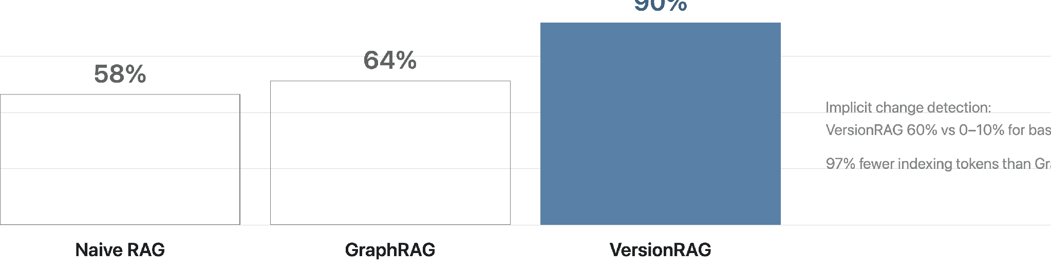
02 · THEME 4 — AMENDMENTS
Amendment and version detection
VersionRAG (Huwiler et al., 2025) models document evolution as a version graph — a direct fit for “new filing supersedes prior filing”, e.g. SC TO-T/A amendments and extended tender deadlines.

Slide 11
02 · THEME 5 — ESCALATION
Escalation and abstention
Conformal prediction gives distribution-free coverage guarantees around a black-box LLM — no retraining needed.
Selective prediction routes low-confidence extractions to people: ExtractConf reaches 99.1% accuracy in its top confidence band on DocILE.
Caution: abstention can be a prompt artifact rather than genuine uncertainty — triggers must reflect real doubt, not a convenient “Unknown” slot.
Design implication: per-field confidence, risk-controlled thresholds, and escalate the whole event when any material field falls short or sources conflict.

Slide 12
02 · THEME 6 — COMPLEX EVENTS
Complex-narrative benchmarks
DATASET
SIZE
SOURCE
WHAT IT TESTS
MAUD
152 merger agreements, 47,457 annotations
Atticus Project, EMNLP 2023
Deal points: closing conditions, MAE definitions, remedies
CUAD
510 contracts, 13,000+ clause annotations
EDGAR
Clause extraction across 41 categories
ContractNLI
~607 NDAs
Document-level NLI
Entailment with multi-span evidence
Fine-tuned baselines struggle on MAUD’s hardest categories, and open models over-emit “no related clause” on CUAD — evidence that voluntary, narrative-heavy events are genuinely harder than dividends and splits.

Slide 13
02 · THEME 7 — CORPUS
A starting corpus
Gold set from EDGAR
Benchmarks and tooling to borrow
SC TO-T / TO-I — tender offers, with their /A amendments
EDGAR-CORPUS and the Stanford EDGAR Filings Dataset for layout-faithful text.
SC 14D9 — target recommendation statements
FinQA, FinanceBench, FinDER and FinAgentBench for retrieval over 10-K, 10-Q, 8-K and DEF-14A.
S-4 and 424B — exchange offers, rights and prospectuses
DEFM14A — merger proxies
An open-source corp-actions-scanner already parses SC TO filings — a starting harness whose regex price extraction the LLM would replace.
8-K Items 1.01 and 8.01 — agreements and “Other Events”

Slide 14
02 · THEME 8 — VENDORS
“The ability to move from deterministic classification to learned, probabilistic classification.”
— Adam Cottingham, SmartStream, on applying AI to narrative issuer announcements
Broadridge, FIS, SimCorp, S&P Global, TCS BaNCS and Vermeg automate the corporate-action lifecycle and STP. None publicly centres a source-grounded, versioned, neutral, confidence-scored event summary — that is the capstone’s differentiation.

Slide 15
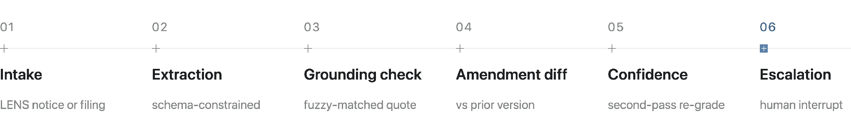
02 · THEME 9 — ARCHITECTURE
Agentic architecture with audit trails
A LangGraph supervisor orchestrates the steps with checkpointing and human-in-the-loop interrupt nodes. Every decision is logged append-only — timestamp, agent, prompt, rationale, source spans — aligned to NIST and ISO/IEC 42001.

Slide 16
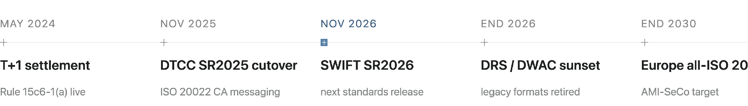
02 · THEME 10 — REGULATION
Regulatory and industry timeline
Compressed windows and mixed MT564 / seev.031 feeds raise the premium on normalising early. No corporate-actions-specific DTCC legacy sunset date was found publicly — verify with BNY’s DTCC liaison.

Slide 17
03
Recommendations

Slide 18
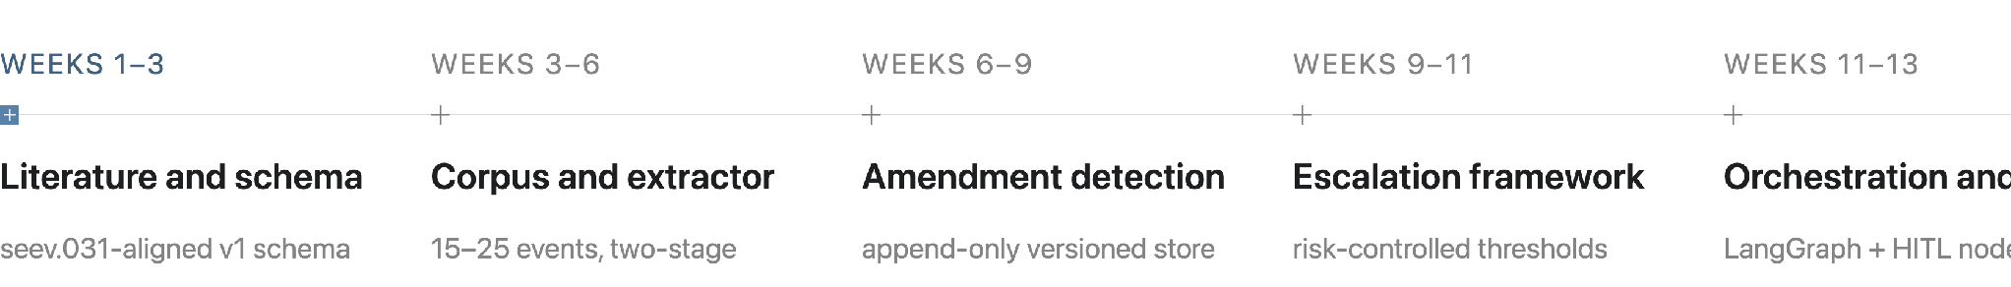
03 · RECOMMENDATIONS
Plan by stage
Gates: ≥90% precision in the top confidence band and ≥95% grounding coverage before adding features; the large majority of injected amendments flagged; auto-processed events hold a ≥95% precision floor.

Slide 19
03 · RECOMMENDATIONS
Evaluation framework
01
Extraction accuracy
field-level precision, recall, F1
02
Completeness of material information
recall against a custodian checklist
03
Source grounding
% fields with a verified verbatim span
04
Amendment detection
precision and recall on supersessions
05
Escalation appropriateness
coverage–risk trade-off (AURC)

Slide 20
03 · RECOMMENDATIONS
Caveats
The two anchor papers are recent preprints; VersionRAG was validated on technical documentation, not filings — re-benchmark on corporate actions.
Manual-processing and loss figures are survey-based and from 2021; volume shares come from trade press. Cite as indicative.
Vendor LLM claims come from vendor marketing and are unverified.
Scarce prior work means no ready benchmark — building the gold set is effort, and also a contribution.

Slide 21
04
Investment case
A five-year return model for the system — what it saves, what it costs, and the tests that decide.

Slide 22
04 · INVESTMENT CASE
The question the model answers
The question
The decision test
Spend once to build the system in year 0. Does what it saves over the next five years justify that spend?
Five years of Net, valued in today’s dollars, must exceed the build cost — NPV ≥ 0.
Net = Benefits − Costs
Everything in the model exists to define that yearly Net: the baseline of manual work today, what the AI changes, and the cost of running it.
Computed for each of the five years.

Slide 23
04 · INVESTMENT CASE
Benefits: released hours and avoided errors
Released hours
Avoided errors
Baseline: events in scope × share not straight-through × minutes per manual event → hours → FTE → labour cost, split mandatory vs voluntary.
Start from today’s annual error cost — make-goods, claims, remediation.
Count only the share rooted in data sourcing and validation, then the share of that the AI eliminates.
Lever 1 fully automates a share of today’s manual events.
Lever 2 shortens handling time where a person is still needed — data pre-filled, source cited.
Error benefit = annual error cost × share rooted in sourcing × share eliminated
Labour benefit = hours released × cost per FTE × realisation rate

Slide 24
04 · INVESTMENT CASE
Costs: four lines
Build and integration
Run and maintenance
AI processing
Governance and platform
One-time, in year 0. Year-0 Net equals minus the build.
Annual, expressed as a share of the build cost.
Per event, scaling with volume as adoption ramps.
Annual model-risk, oversight and platform cost.
Yearly Net = labour benefit + error benefit − costs

Slide 25
04 · INVESTMENT CASE
Outputs and the question each answers
OUTPUT
QUESTION IT ANSWERS
Payback
How many years until cumulative savings cover the build?
ROI on upfront investment
Net operating benefit earned on the build — five-year and per-year
Break-even build cost
The most the build could cost before the case stops working
NPV and IRR
Value in today’s dollars and the equivalent annual return

Slide 26
CORPORATE ACTION INTELLIGENCE TEAM
Thank you
Questions, and what we should verify with BNY before Stage 1 closes.
Aesha Gandhi
·
Pranshul Bhatnagar
·
Alex Li
·
Kedar Vaidya
·
Aaron Jiang

